Slide 1
Lactose Intolerance
By: Gabbie Rodrigues
&
Hailey Almeida

Slide 2
What is Lactose Intolerance?
Lactose intolerance is the
inability to digest lactose.
Lactose is a type of sugar
found in milk and other dairy products.

Slide 3
Life Threatening?????
This is not a life threatening dietary
restriction. When people with lactose
intolerance eat dairy products, they may
experience abdominal bloating, cramps,
diarrhea, gas, nausea and infants or
children may have slow growth or weight
loss. These symptoms occur from 30 minutes to 2 hours after consuming dairy products.

Slide 4
How many people have it???
60% of Americans are lactose intolerance

Slide 5
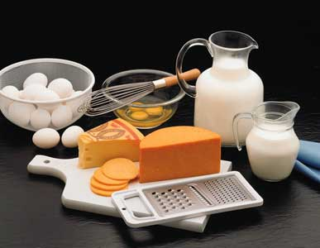
Foods?
Milk
Ice-cream
Cream
Butter
Yogurt
Cheese
Bread
Cereal
Baking mixes
Instant potatoes
Soups
Nondairy creamers
Whipped toppings
Protein powder and bars
Breakfast and meal replacement drinks
Deli meats
Frozen entrees
Potato chips
Candy
Salad dressing
Birth contol pills
Other medications
Soy and rice milk

Slide 6
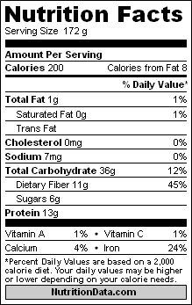
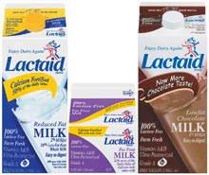
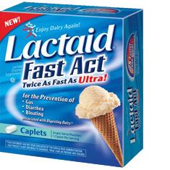
Steps and precautions
Ask your doctor about medication,
like lactaid, and foods that you can/cannot eat
Look at all labels on foods for
ingredients that cause your symptoms
Limit your consumption of dairy products

Slide 7
Sources!!!
Source one
http://www.ncbi.nlm.nih.gov/pubmedhealth/PMH0001321/
Source two
http://www.livestrong.com/article/351128-list-of-foods-to-avoid-for-lactose-intolerance/

